Slide 1
WELCOME
Decoding HR Data:
Key Insights & Findings
A simple, clear look at what our employee data really tells us
Meta data of dataset
The dataset was provided by the ExcleR project team with file name HR_1 & HR_2
HR Analytics Project • Employees Insights Presentation

Slide 2
Project Team
The people behind this analysis
SS
AS
MR
KK
Shrutika Shantaram Kanse
Anne Saadhuri
Malepati Rajitha
Kartik Kasrale
Reporting & Presentation
Team Leader, Tableau Dashboard
Quality Checking & SQL Queries
Power BI Dashboard Building & analysis
GV
JJ
SP
Ganesh Vitthal Khillari
Jeeban Jyoti Das
Sasmita Panigrahi
Project Documentation
Excel Dashboard (Pivot Tables) & Quality checking
Data Cleaning & Data Preparation & reporting & presentation
2

Slide 3
Project Agenda
What we will cover in this presentation
1
Project team introduction
2
Problem statement based on our data analysis
3
Power BI dashboard walkthrough
4
Excel dashboard walkthrough
5
Key insights explained one by one
6
Final conclusion from the HR data
3

Slide 4
Problem Statement
Why we looked closely at this employee data
Our Tean wants to understand why Employeess leave, whether pay is fair, and whether performance is rewarded properly — but our own analysis raises doubts about the data itself.
Problems identified from our insights:
1
Attrition cannot be explained: overtime, satisfaction, income, and tenure all show almost no link to who leaves, so HR has no clear early-warning signal to act on.
2
Pay looks unusually flat: gender, department, and even job level barely change average income, making it hard to confirm whether the pay structure is genuinely fair or simply flat data.
3
Performance is not rewarded differently: high and low performance ratings receive almost the same salary hike, weakening the motivation performance reviews are meant to create.
4
Several fields carry no information at all (Standard Hours, Over18, Employees Count), wasting space and adding no analytical value.
5
Nearly every category — gender, department, job role, education field, work-life balance — is split almost perfectly evenly, which is very unusual for a real workforce.
6
Together, these gaps raise one core question: is this genuine company data, or is it partly simulated — and can we safely use it to make real HR decisions?
4

Slide 5
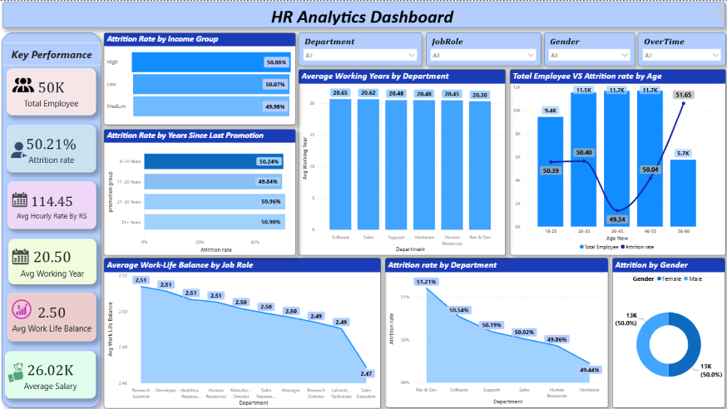
Power BI Dashboard
5

Slide 6

Power BI Dashboard
KPI Card 1 : Show Total count Employees (in Thousands)
Problem : to Identify The Total Number of Employees according our filtering Condition
Key Insight using KPI
We find Total Number of is 50K Employees including The 25K Female Employees and 25K Male Employees.
We find the Employees in each Department having Around 4K Male Employees Present in Each Department as same Number as like Male Employees Around 4K Female Employees are Work in each Department Group.
Around 25K Employees Do Over time Work
Tip: May have use Around word because we find the Number in Thousands may be Actual Number is different
6

Slide 7
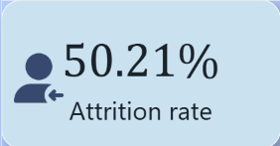
Power BI Dashboard
KPI Card 2 : Show Total Attrition Rate Employees (in %) in short (AR)
Problem : To Identify The Total Attrtion Rate (%)of of Employees according our filtering Condition
Key Insight Using KPI
Total AR is 50.21 % Employees including The Female Employees and Male Employees.
AR of Gender Wise Female AR is 50.36 % and AR is 50.64%
From Each Department Female Employees AR is in between the 49 % to 53%
and Male Employees in each Department in between 45% to 50% According this Number we say the AR of Female is High.
Total AR From Employees Who Do Work Over time = 49.34%
6

Slide 8
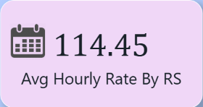
Power BI Dashboard
KPI Card 3 : Show Average Hourly rate Employees (in INR)
Problem : To Identify The Average Hourly rates of Employees according our filtering Condition
Key Insight using KPI
Overall Employees Hourly rate is ₹114.45 INR including Female Employees and & Male Employees.
Female Employee Hourly Rate is :=₹ 114.45 INR
Male Employee Hourly Rate:= ₹114.45 INR
Employees Do Over time Work = ₹116.36 INR , Not do OT=₹ 112.32 INR
6

Slide 9
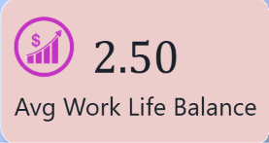
Power BI Dashboard
KPI Card 4: Show Total AVG WORK Life Balance Rating
Problem : To Identify The Avg Rating of Employees Reguarding Their Work Life Balance according our filtering Condition
Key Insight using KPI
Total Average Work Life Balances Rating is 2.50
Female Employees Average Work Life Rating= 2.51 , and for Male = 2.49.
Employees in each Department having Avg Rating for work life balance 2.50 around only Support ,Hardware Dept avg work life balance rating is 2.31
These Employees Do Over time Work these work life balance rating is 2.50 these do not work OT their Average work life balance rating is 2.49
6

Slide 10

Power BI Dashboard
KPI Card 5 : Show Total Average of Employees (in Thousands)
Problem : To Identify The Average Salary of Employees according our filtering Condition
Key Insight using KPI
The Avg Salary of Total Employees is 24.16 K including all The 25K Female Employees and 25K Male Employees.
Average Salary the Employees in each Department having Around in between 25 k to 27k Male Employees Avg Salary in Department is range of 25.50K to 27.50 K as like Female Employees in each Depart. Their average Salary is Around 26.00 K to 27.50 K.
Around 25K Employees Do Over time Work
6

Slide 11
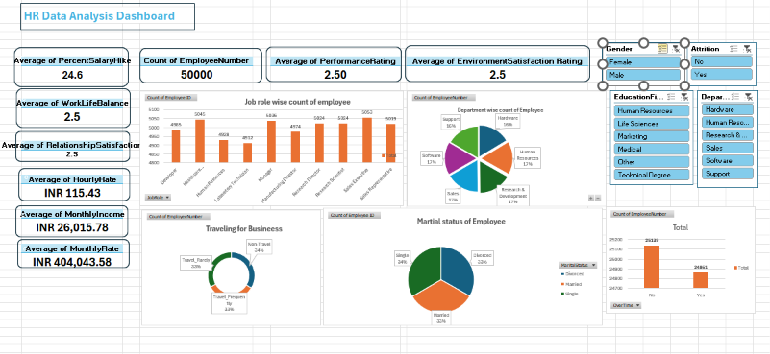
A second view of the same data, in Excel
Excel Dashboard
In short:
Bult using pivot tables and charts directly from the HR_1 and HR_2 data.
Lets us filter by department, job role, or gender in one click.
Confirms the same flat, evenly-spread patterns seen in Power BI.
Useful as a lightweight, easy-to-share version of the dashboard.
7

Slide 12
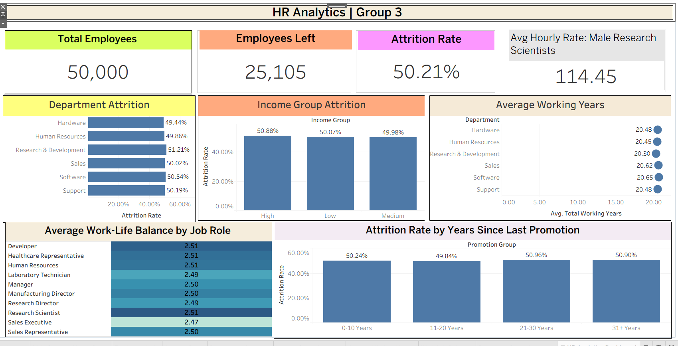
Tableau Dashboard Third view of same data Tableau

Slide 13
Final Key Insights (1 of 2)
1. Attrition Has No Clear Driver
2. No Pay Gap by Gender or Department
Attrition stays near 50% across every category tested.
Overtime, department, and income show almost no effect. We think that’s why Employees are leave our compony
Age, tenure, and marital status also don't predict it.
Job satisfaction levels make almost no difference either.
This points to attrition being essentially random here.
Male and female average income is nearly identical.
All departments pay within a very narrow, tight range.
Job Level 1 to Level 5 shows barely any income jump.
Senior roles do not clearly earn more than junior ones.
This may reflect fairness, or an overly flat dataset.
3. Tenure Fields Behave Realistically
4. The Workforce Looks Artificially Balanced
Years at Company links closely to Years in Current Role.
It also links to Years with Manager and Total Working Years.
Years Since Promotion moves together with these too.
This part of the data follows real-world logical patterns.
It can be trusted for genuine workforce planning use.
Gender split is close to an exact 50/50 across Employeess.
All six departments hold nearly the same headcount.
Work-Life Balance ratings split evenly into four groups.
Job roles and education fields are also evenly spread.
Such perfect balance is rare in a real organization.
8

Slide 14
Key Insights (2 of 2)
5. Performance and Reward Are Disconnected
6. Several Columns Add No Value
7. Categorical Fields Are Too Evenly Spread
Salary hike % is almost flat across all rating levels.
Top performers get about the same raise as low ones.
There is no strong pay-for-performance link visible.
Real systems usually reward high performers more.
HR may want to revisit how raises are decided.
Standard Hours, Over18, and Employees Count never change.
Every employee shares the exact same value in these.
These columns carry zero useful analytical information.
They can be safely dropped from future reports.
This keeps the dataset cleaner and easier to use.
Job Role and Education Field are nearly uniform in size.
Number of Companies Worked is spread almost equally too.
Distance From Home barely differs across departments.
This evenness is unusual for real hiring patterns.
It further suggests the data may be simulated.
9

Slide 15
Conclusion
What the HR-1 and HR-2 data finally tell us
1
Attrition, satisfaction, and pay-for-performance show no real patterns in this data.
2
Pay looks fair and flat across gender and department, with almost no gap.
3
Tenure-related fields (years at company, role, manager) are internally consistent and reliable.
4
The overall dataset is very evenly spread across almost every category, which is unusual for a real company.
5
Overall, this data looks partly synthetic — good for practicing analysis, but not strong enough to base real HR decisions on without further validation.
10

